Slide 1
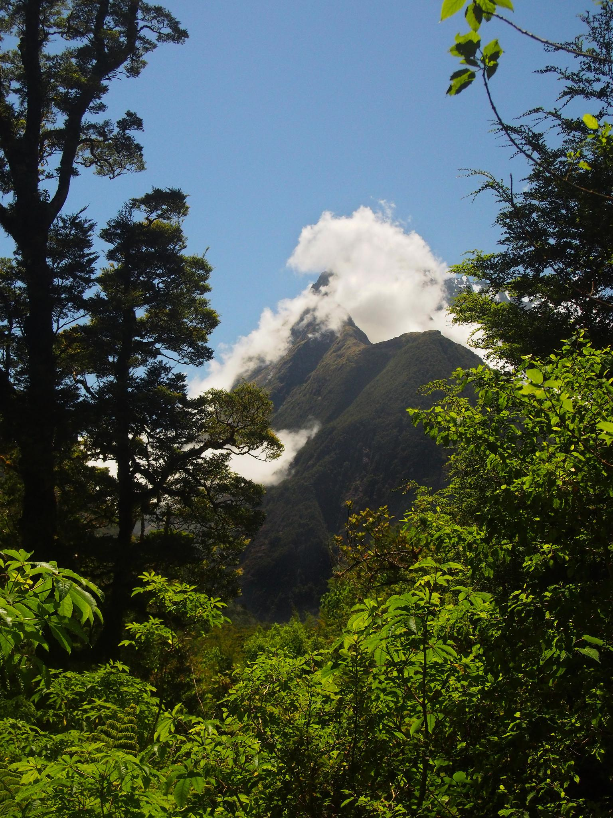
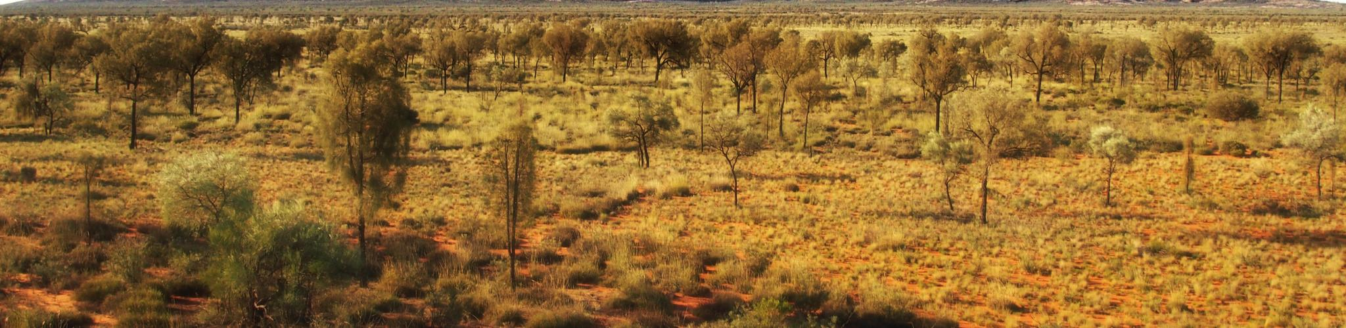
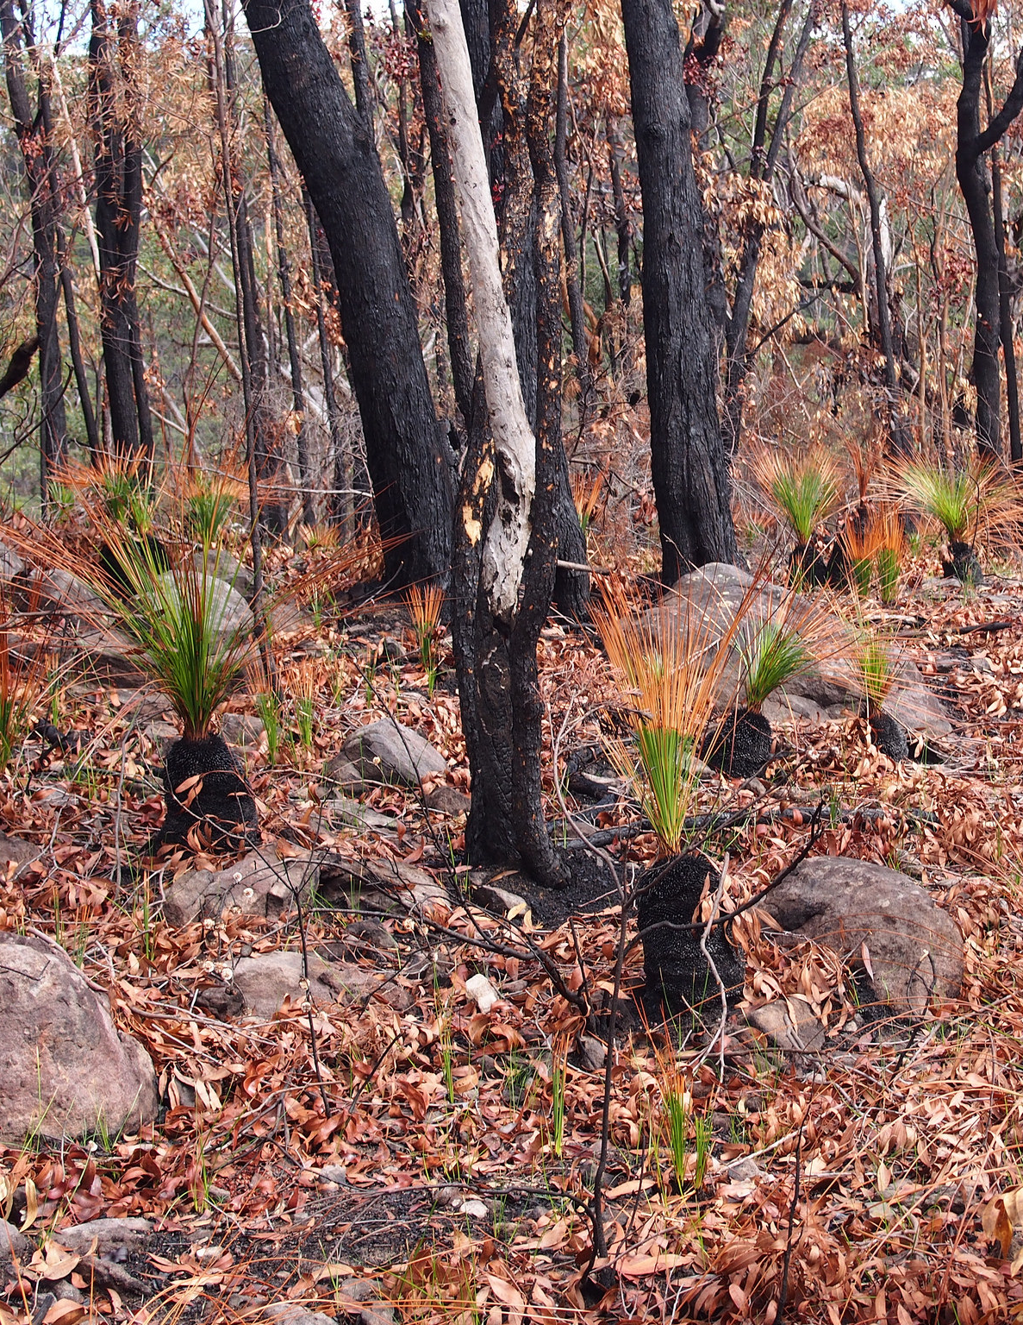
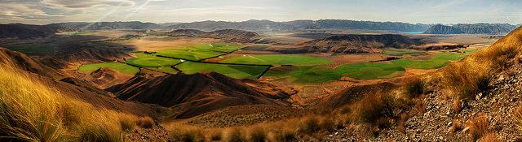

Vegetation Distribution JPEG

Slide 2

Vegetation Distribution JPEG

Slide 3





Vegetation Distribution JPEG

Slide 4

Vegetation Distribution JPEG

Slide 5


Vegetation Distribution JPEG

Slide 6



Vegetation Distribution JPEG

Slide 7
Started May 2018
Douglas Kelley, Chantelle Burton, France Gerard, Eddy Robertson, Rich Ellis, Graham Weedon, Rhys Whitley, Karina Williams, Alistair Sellar, Stephanie Woodward, Rachel Turton, Andy Wiltshire, Chris Jones, Eleanor Burke, Andrew Hartley, Debbie Hemming, Sarah Chadburn, Edward Comyn-Platt

Slide 8
Sub-JPEGS
Collate LAI datasets
Observations JPEG
Veg frac with uncertainty estimates
to help JULES evaluation/calibration
Reduce uncertainty with CCI based on high resolution original data
“Mortality” JPEG
Productive vegetation competition and distribution
Representation and magnitude of disturbance
Post-disturbance recovery rate
Arid-veg JPEG
Too high bare soil in arid regions
Vegetation can be over-sensitive to moisture availability
Test response to variability at different timescales (seasonal, annual, decadale etc)
Phenology JPEG
Lack of cold deciduousness in grasses
Drought phenology untested
Assessment of veg-frac “shrinkage” from seasonal carbon starvation

Slide 9
Sub-JPEGS
Collate LAI datasets
Observations JPEG
Veg frac with uncertainty estimates
to help JULES evaluation/calibration
Reduce uncertainty with CCI based on high resolution original data
“Mortality” JPEG
Productive vegetation competition and distribution
Representation and magnitude of disturbance
Post-disturbance recovery rate
Arid-veg JPEG
Too high bare soil in arid regions
Vegetation can be over-sensitive to moisture availability
Test response to variability at different timescales (seasonal, annual, decadale etc)
Phenology JPEG
Lack of cold deciduousness in grasses
Drought phenology untested
Assessment of veg-frac “shrinkage” from seasonal carbon starvation

Slide 10
Vegetation Dynamics JPEGS
Collate LAI datasets
Observations JPEG
Veg frac with uncertainty estimates
to help JULES evaluation/calibration
Reduce uncertainty with CCI based on high resolution original data
“Mortality” JPEG
Productive vegetation competition and distribution
Representation and magnitude of disturbance
Post-disturbance recovery rate
Arid-veg JPEG
Too high bare soil in arid regions
Vegetation can be over-sensitive to moisture availability
Test response to variability at different timescales (seasonal, annual, decadale etc)
Phenology JPEG
Lack of cold deciduousness in grasses
Drought phenology untested
Assessment of veg-frac “shrinkage” from seasonal carbon starvation

Slide 11
Arid-veg SJPEG
Andy W/Eddy R/Spencer/Chantelle etc: JULES-ES veg frac comparisons vs IGBP.
Rich E/Eddy R/Chantelle: vegetated fraction in climate space (MAP, MAT, seasonality etc)
Karina: Soil moisture suite and JPEG crossover

Slide 12

Vegetation Dynamics JPEGS
Collate LAI datasets
Observations JPEG
Veg frac with uncertainty estimates
to help JULES evaluation/calibration
Reduce uncertainty with CCI based on high resolution original data
“Mortality” JPEG
Productive vegetation competition and distribution
Representation and magnitude of disturbance
Post-disturbance recovery rate
Arid-veg JPEG
Too high bare soil in arid regions
Vegetation can be over-sensitive to moisture availability
Test response to variability at different timescales (seasonal, annual, decadale etc)
Phenology JPEG
Lack of cold deciduousness in grasses
Drought phenology untested
Assessment of veg-frac “shrinkage” from seasonal carbon starvation

Slide 13
JULES runs
JULES-“RH” from Burton et al. 2018 GMDD
  SF3: “Control” inc. Land use & Fire disturbance
  SF2: No land use, just fire
  S 3: No fire, just land use
  S 2: No fire or land use.
Upgrade to JULES-ES when fire biogeochemical feedbacks are included

Slide 14
Disturbance
None
Fire
Drought
High temperatures
People
All
Land Use
None
S2
SF2
SF2?
Crop
Pasture
All
S3
SF3
SF3?

Slide 15
Disturbance
None
Fire
Drought
High temperatures
People
All
Land Use
None
S2
Seasonal Rainfall Distribution!
SF2
SF2?
Crop
Pasture
All
S3
SF3
SF3?

Slide 16
Model benchmarking
Null
Models
Simple & optimized
Randomly Resampled
Perfect
Median
Mean
Worse
NME/NMSE
Spatial,
Inter-annual, trends
Site
Season length
MM/SCD
Fractional cover
MPD
Season timing,
Inter-annual oscillations
DNME
Spatial gradients
DMM/SDMM
Biome/item comparisons
~ 0.4 - 0.7*
~ 0.7*
1
~1.2 - 1.4*
∞
0
0
*
~ 0.7*
1
~1.2 - 1.4*
∞
0
~ 0.1 - 0.3*
2
~ 0.7*
~1*
~ 1*
0
*
*
*
*
1
~ 0.4 - 0.7*
~ 0.7*
1
~1.2 - 1.4*
∞
0
0
~ 0.5*
~1
~1.2 - 1.4*
2
Kelley et al. Comprehensive benchmarking, BG 2013; Rabbin et al. fireMIP phase 1, GMD, 2017
*dataset dependant

Slide 17
Model benchmarking
Comparison | Dataset | Time period | - | LU | Fire | LU + Fire
Life form | VCF | 2002-2012 | 0.78 | 0.6 | 0.54 | 0.51
 | CCI | 2010 | 0.72 | 0.6 | 0.64 | 0.63
Tree Cover |  |  | 0.35 | 0.28 | 0.3 | 0.3
Wood Cover | VCF | 2002-2012 | 0.64 | 0.43 | 0.33 | 0.29
 | CCI | 2010 | 0.45 | 0.31 | 0.35 | 0.36
Herb cover | VCF | 2002-2012 | 0.64 | 0.48 | 0.43 | 0.42
 | CCI | 2010 | 0.43 | 0.33 | 0.4 | 0.42
Leaf type | VCF | 1992-1993 | 0.56 | 0.55 | 0.5 | 0.53
 | CCI | 2010 | 0.56 | 0.56 | 0.51 | 0.54
BL |  |  | 0.18 | 0.15 | 0.17 | 0.17
NL |  |  | 0.25 | 0.22 | 0.18 | 0.17
C3 |  |  | 0.34 | 0.36 | 0.38 | 0.43
C4 |  |  | 0.2 | 0.21 | 0.21 | 0.21
Shrub |  |  | 0.36 | 0.28 | 0.26 | 0.23

Slide 18
Model benchmarking
Comparison | Dataset | Time period | - | LU | Fire | LU + Fire
Life form | VCF | 2002-2012 | 0.78 | 0.6 | 0.54 | 0.51
 | CCI | 2010 | 0.72 | 0.6 | 0.64 | 0.63
Tree Cover |  |  | 0.35 | 0.28 | 0.3 | 0.3
Wood Cover | VCF | 2002-2012 | 0.64 | 0.43 | 0.33 | 0.29
 | CCI | 2010 | 0.45 | 0.31 | 0.35 | 0.36
Herb cover | VCF | 2002-2012 | 0.64 | 0.48 | 0.43 | 0.42
 | CCI | 2010 | 0.43 | 0.33 | 0.4 | 0.42
Leaf type | VCF | 1992-1993 | 0.56 | 0.55 | 0.5 | 0.53
 | CCI | 2010 | 0.56 | 0.56 | 0.51 | 0.54
BL |  |  | 0.18 | 0.15 | 0.17 | 0.17
NL |  |  | 0.25 | 0.22 | 0.18 | 0.17
C3 |  |  | 0.34 | 0.36 | 0.38 | 0.43
C4 |  |  | 0.2 | 0.21 | 0.21 | 0.21
Shrub |  |  | 0.36 | 0.28 | 0.26 | 0.23

Slide 19
Model benchmarking
Comparison | Dataset | Time period | - | LU | Fire | LU + Fire
Life form | VCF | 2002-2012 | 0.78 | 0.6 | 0.54 | 0.51
 | CCI | 2010 | 0.72 | 0.6 | 0.64 | 0.63
Tree Cover |  |  | 0.35 | 0.28 | 0.3 | 0.3
Wood Cover | VCF | 2002-2012 | 0.64 | 0.43 | 0.33 | 0.29
 | CCI | 2010 | 0.45 | 0.31 | 0.35 | 0.36
Herb cover | VCF | 2002-2012 | 0.64 | 0.48 | 0.43 | 0.42
 | CCI | 2010 | 0.43 | 0.33 | 0.4 | 0.42
Leaf type | VCF | 1992-1993 | 0.56 | 0.55 | 0.5 | 0.53
 | CCI | 2010 | 0.56 | 0.56 | 0.51 | 0.54
BL |  |  | 0.18 | 0.15 | 0.17 | 0.17
NL |  |  | 0.25 | 0.22 | 0.18 | 0.17
C3 |  |  | 0.34 | 0.36 | 0.38 | 0.43
C4 |  |  | 0.2 | 0.21 | 0.21 | 0.21
Shrub |  |  | 0.36 | 0.28 | 0.26 | 0.23

Slide 20
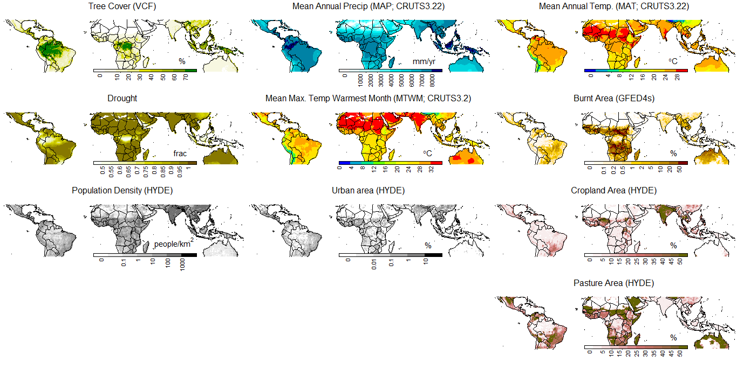
Tree cover controls assessment
Plot of inputs

Slide 21
Tree cover controls assessment
Plot of inputs

Slide 22
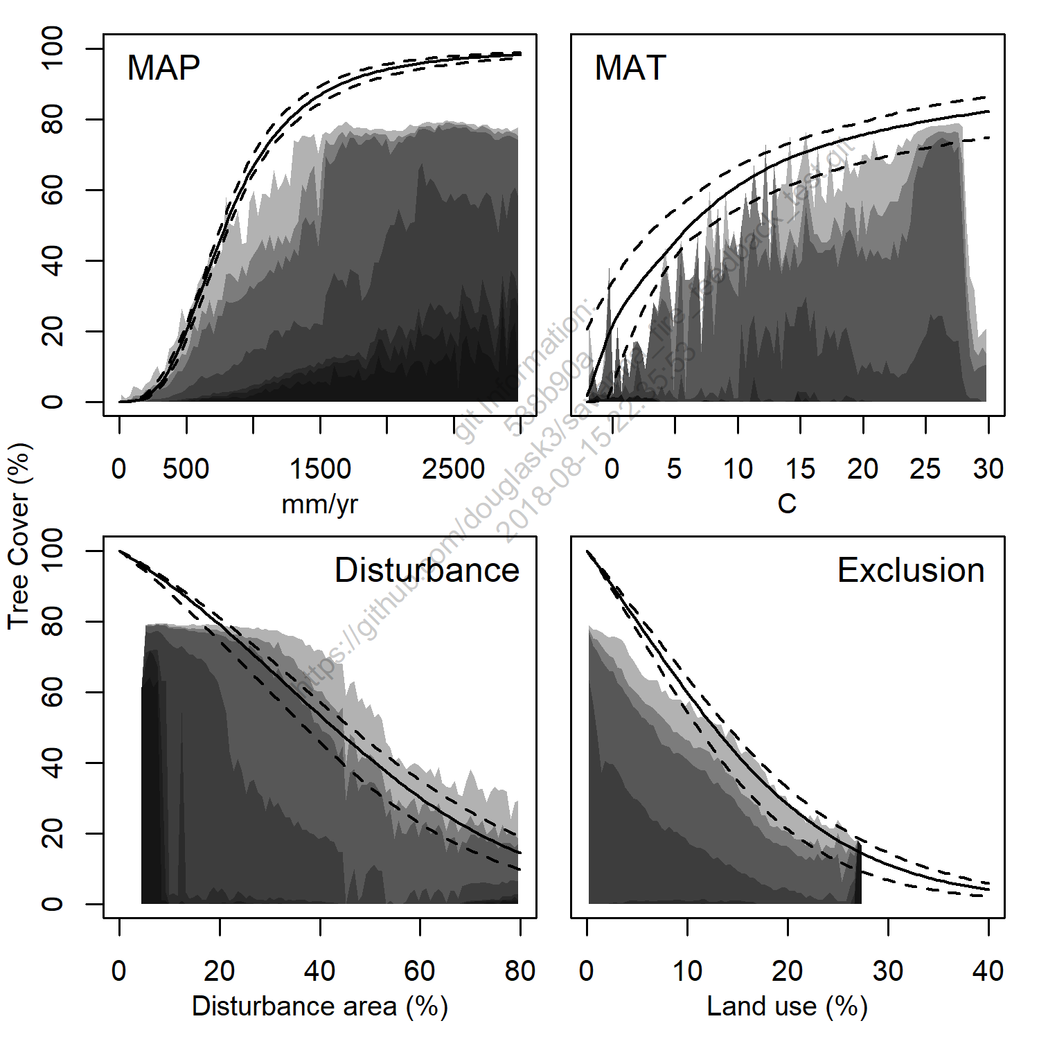
Tree cover controls assessment

Slide 23
Tree cover controls assessment

Slide 24
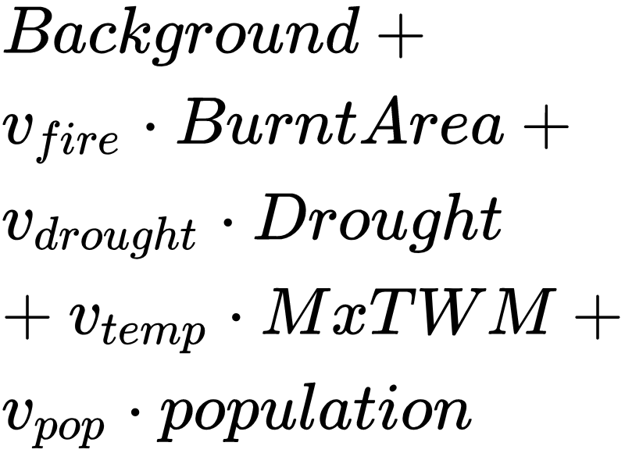
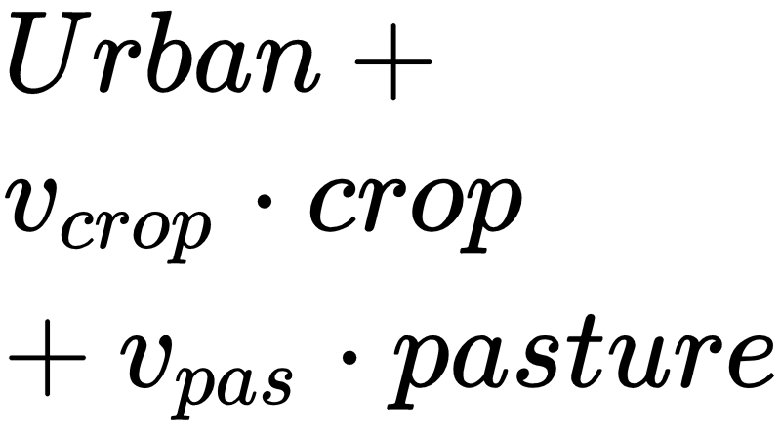
Tree cover controls assessment

Slide 25
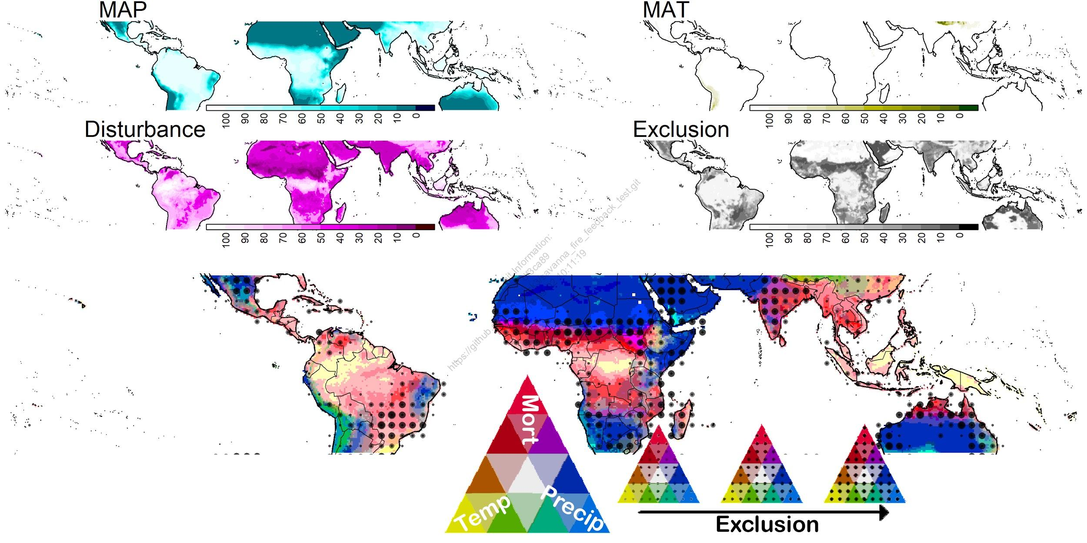
Tree cover controls assessment
Plot of inputs

Slide 26
Tree cover controls assessment
Plot of inputs

Slide 27
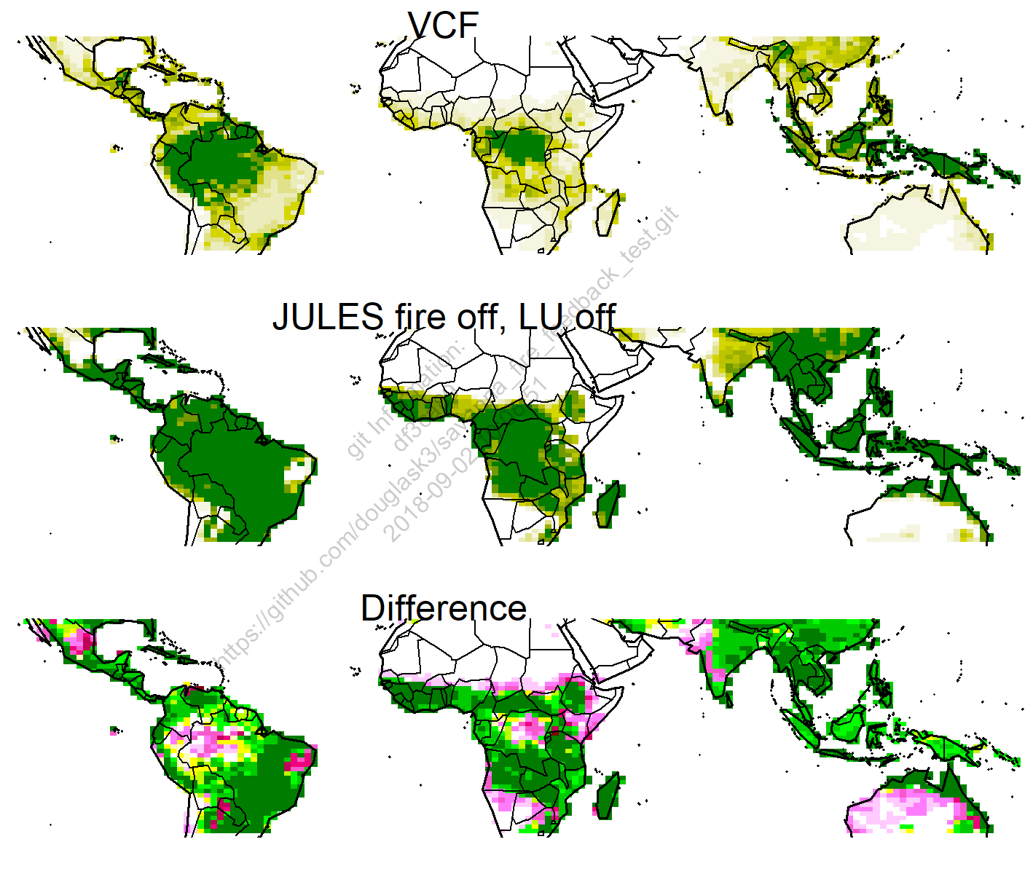
Jules Comparison - S2

Slide 28
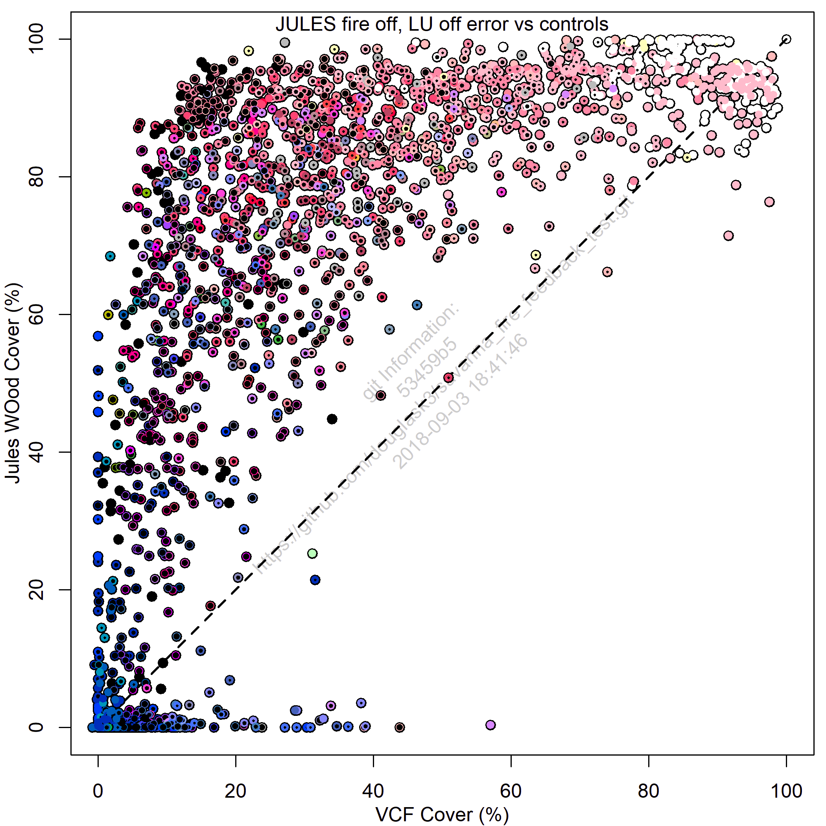
Jules Comparison - S2

Slide 29
Jules Comparison - S2
Simulates tree cover when should be limited by MAP

Slide 30
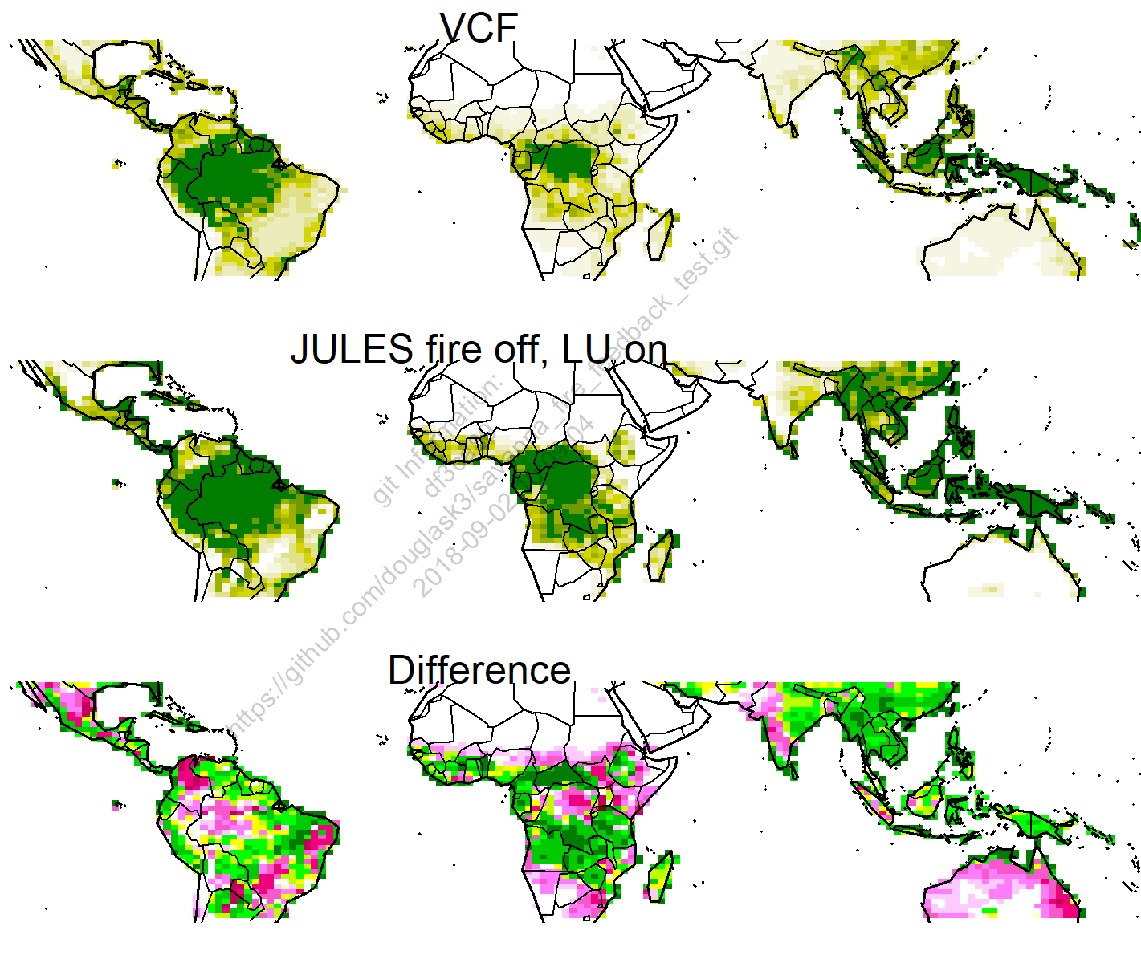
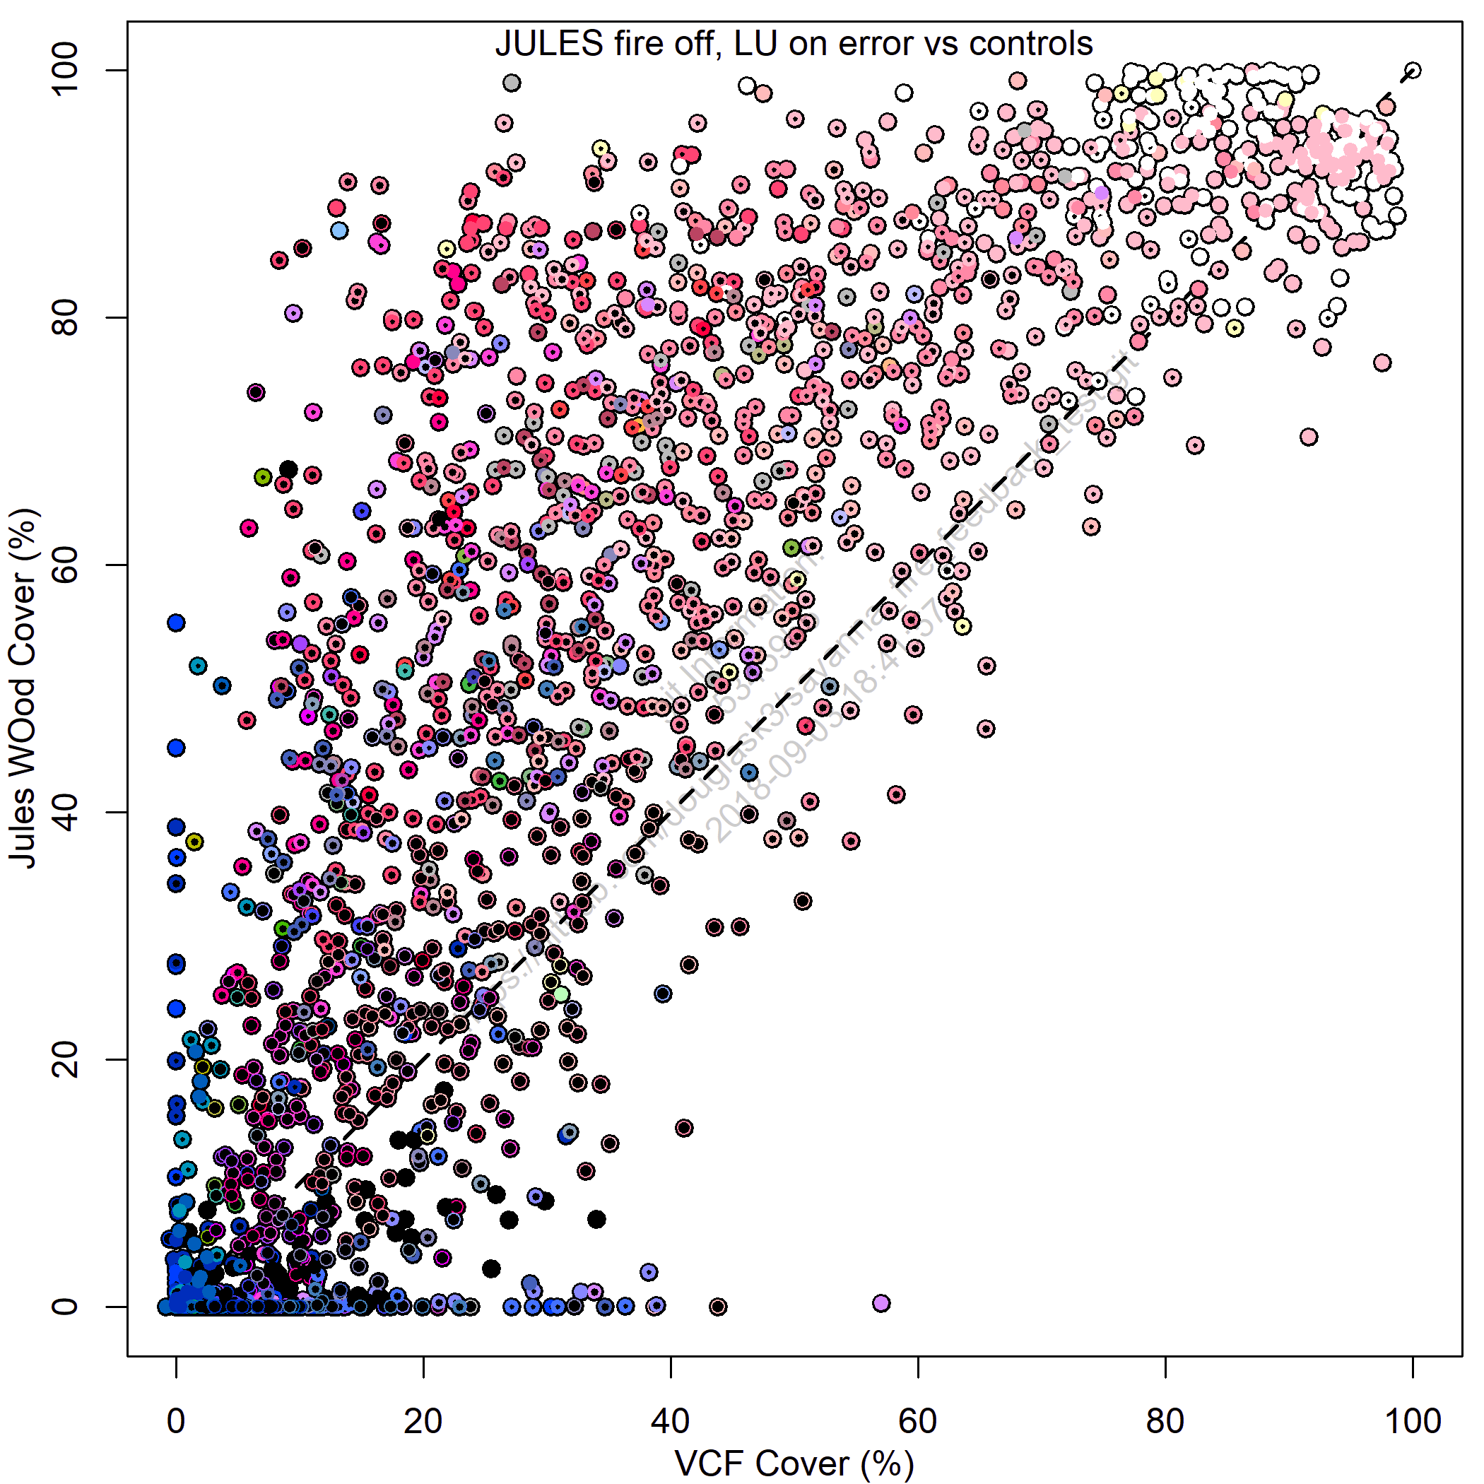
Jules Comparison - S3
Exclusion controlled moved to 1:1 line, suggesting good representation of land use
should be limited by MAP

Slide 31
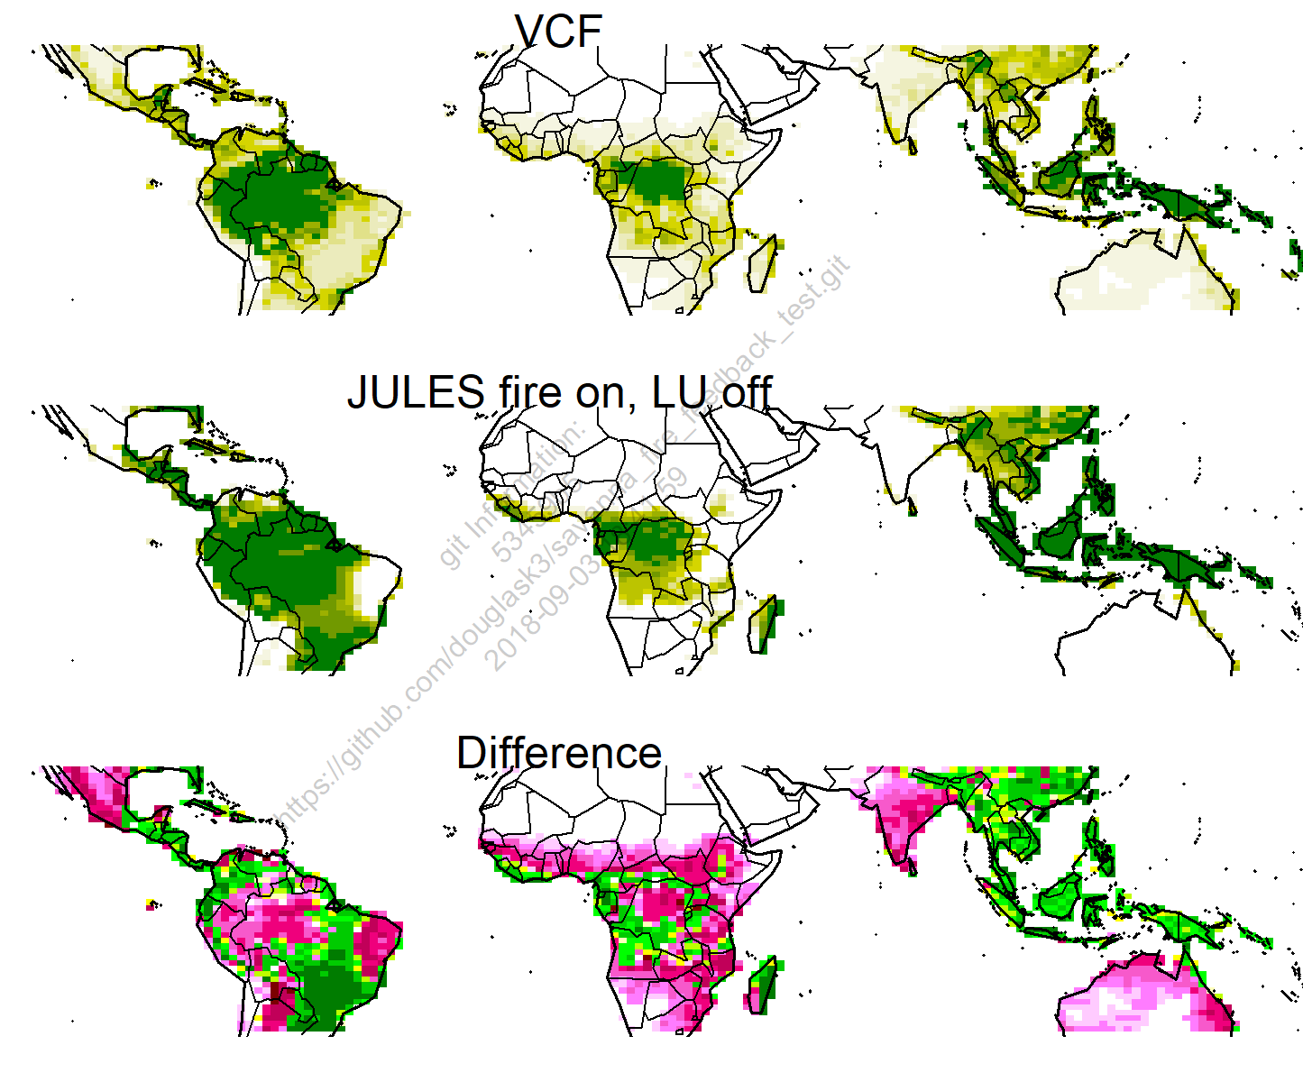
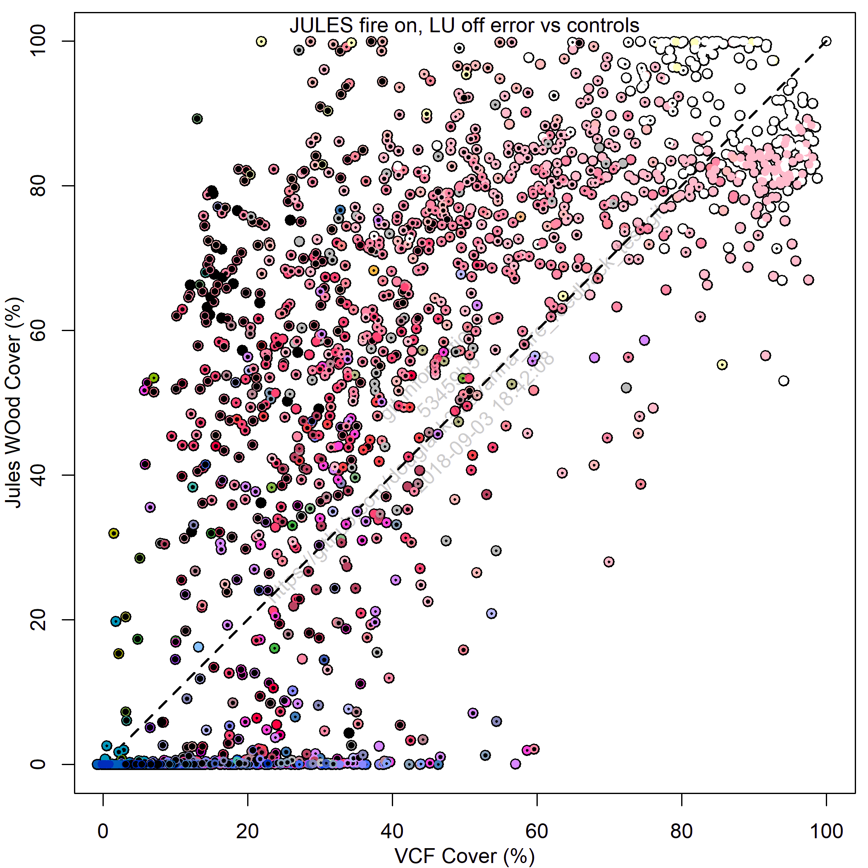
Jules Comparison - SF2
Fire reduces tree cover to 0 for
many areas

Slide 32
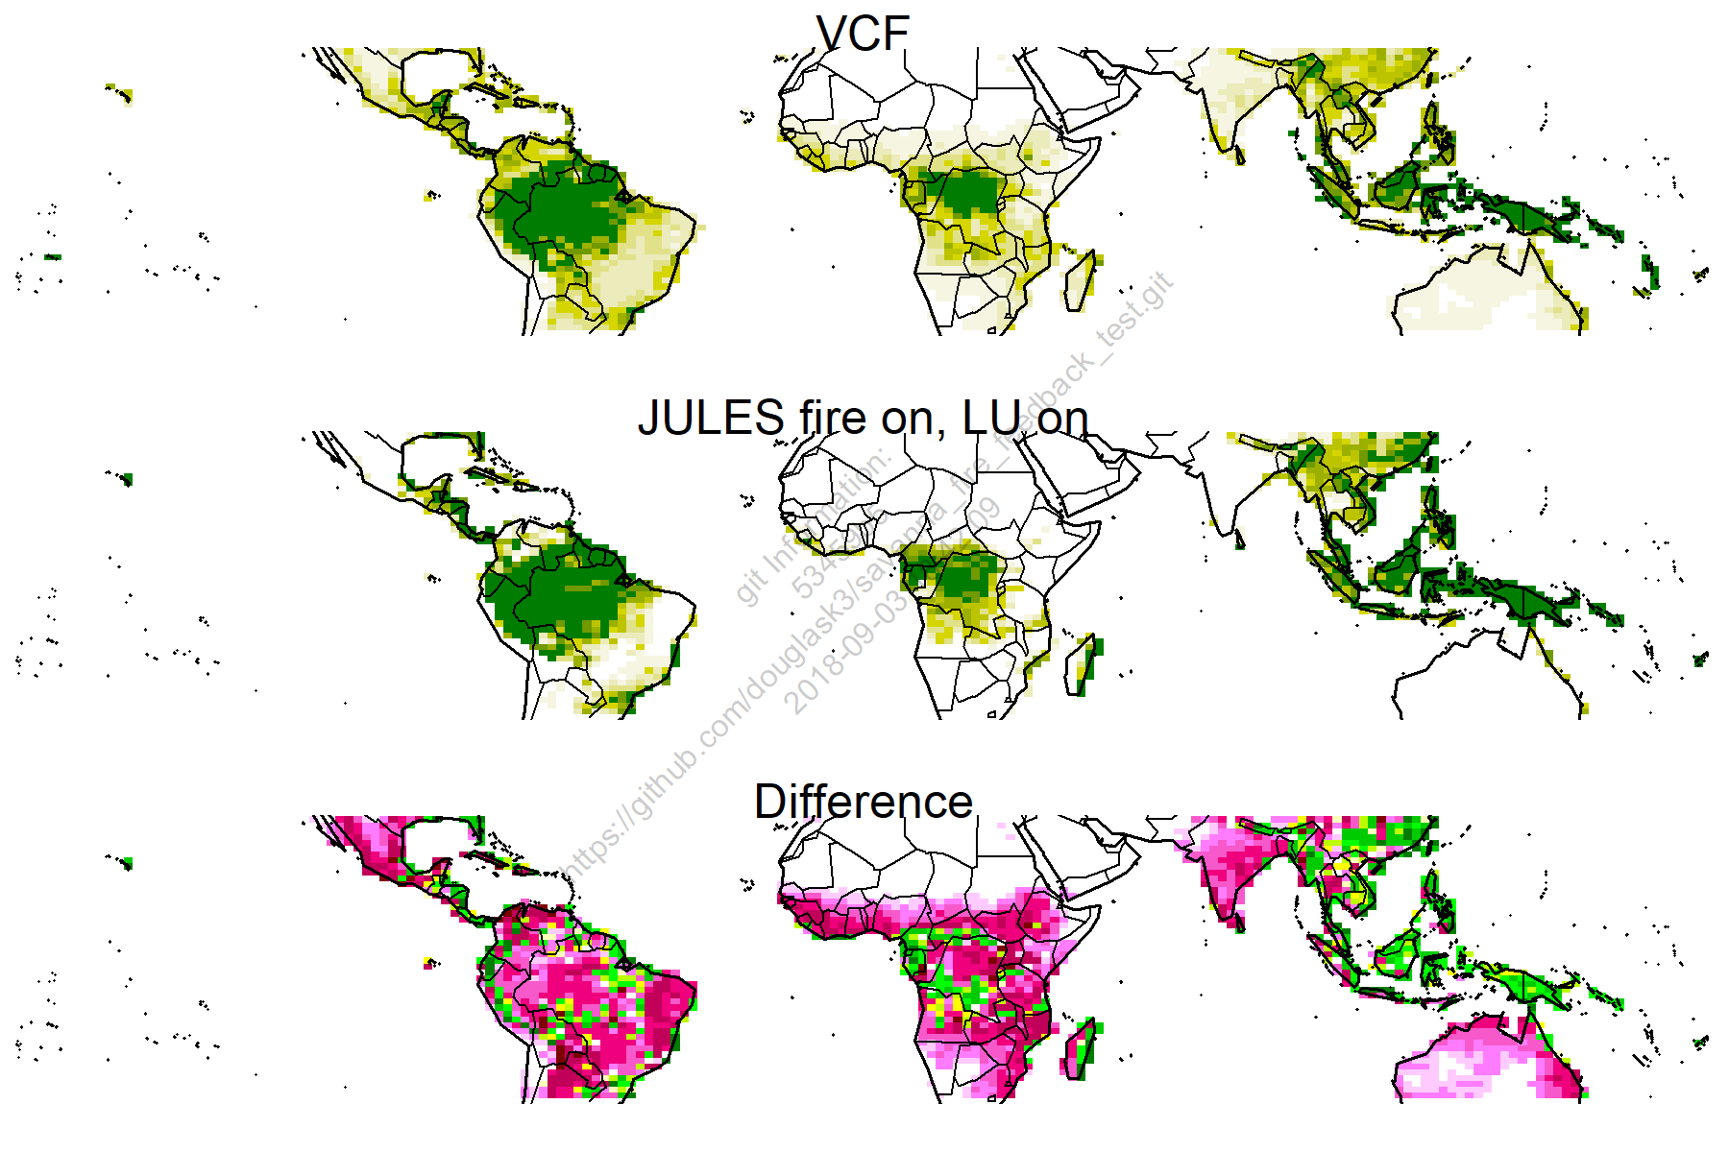
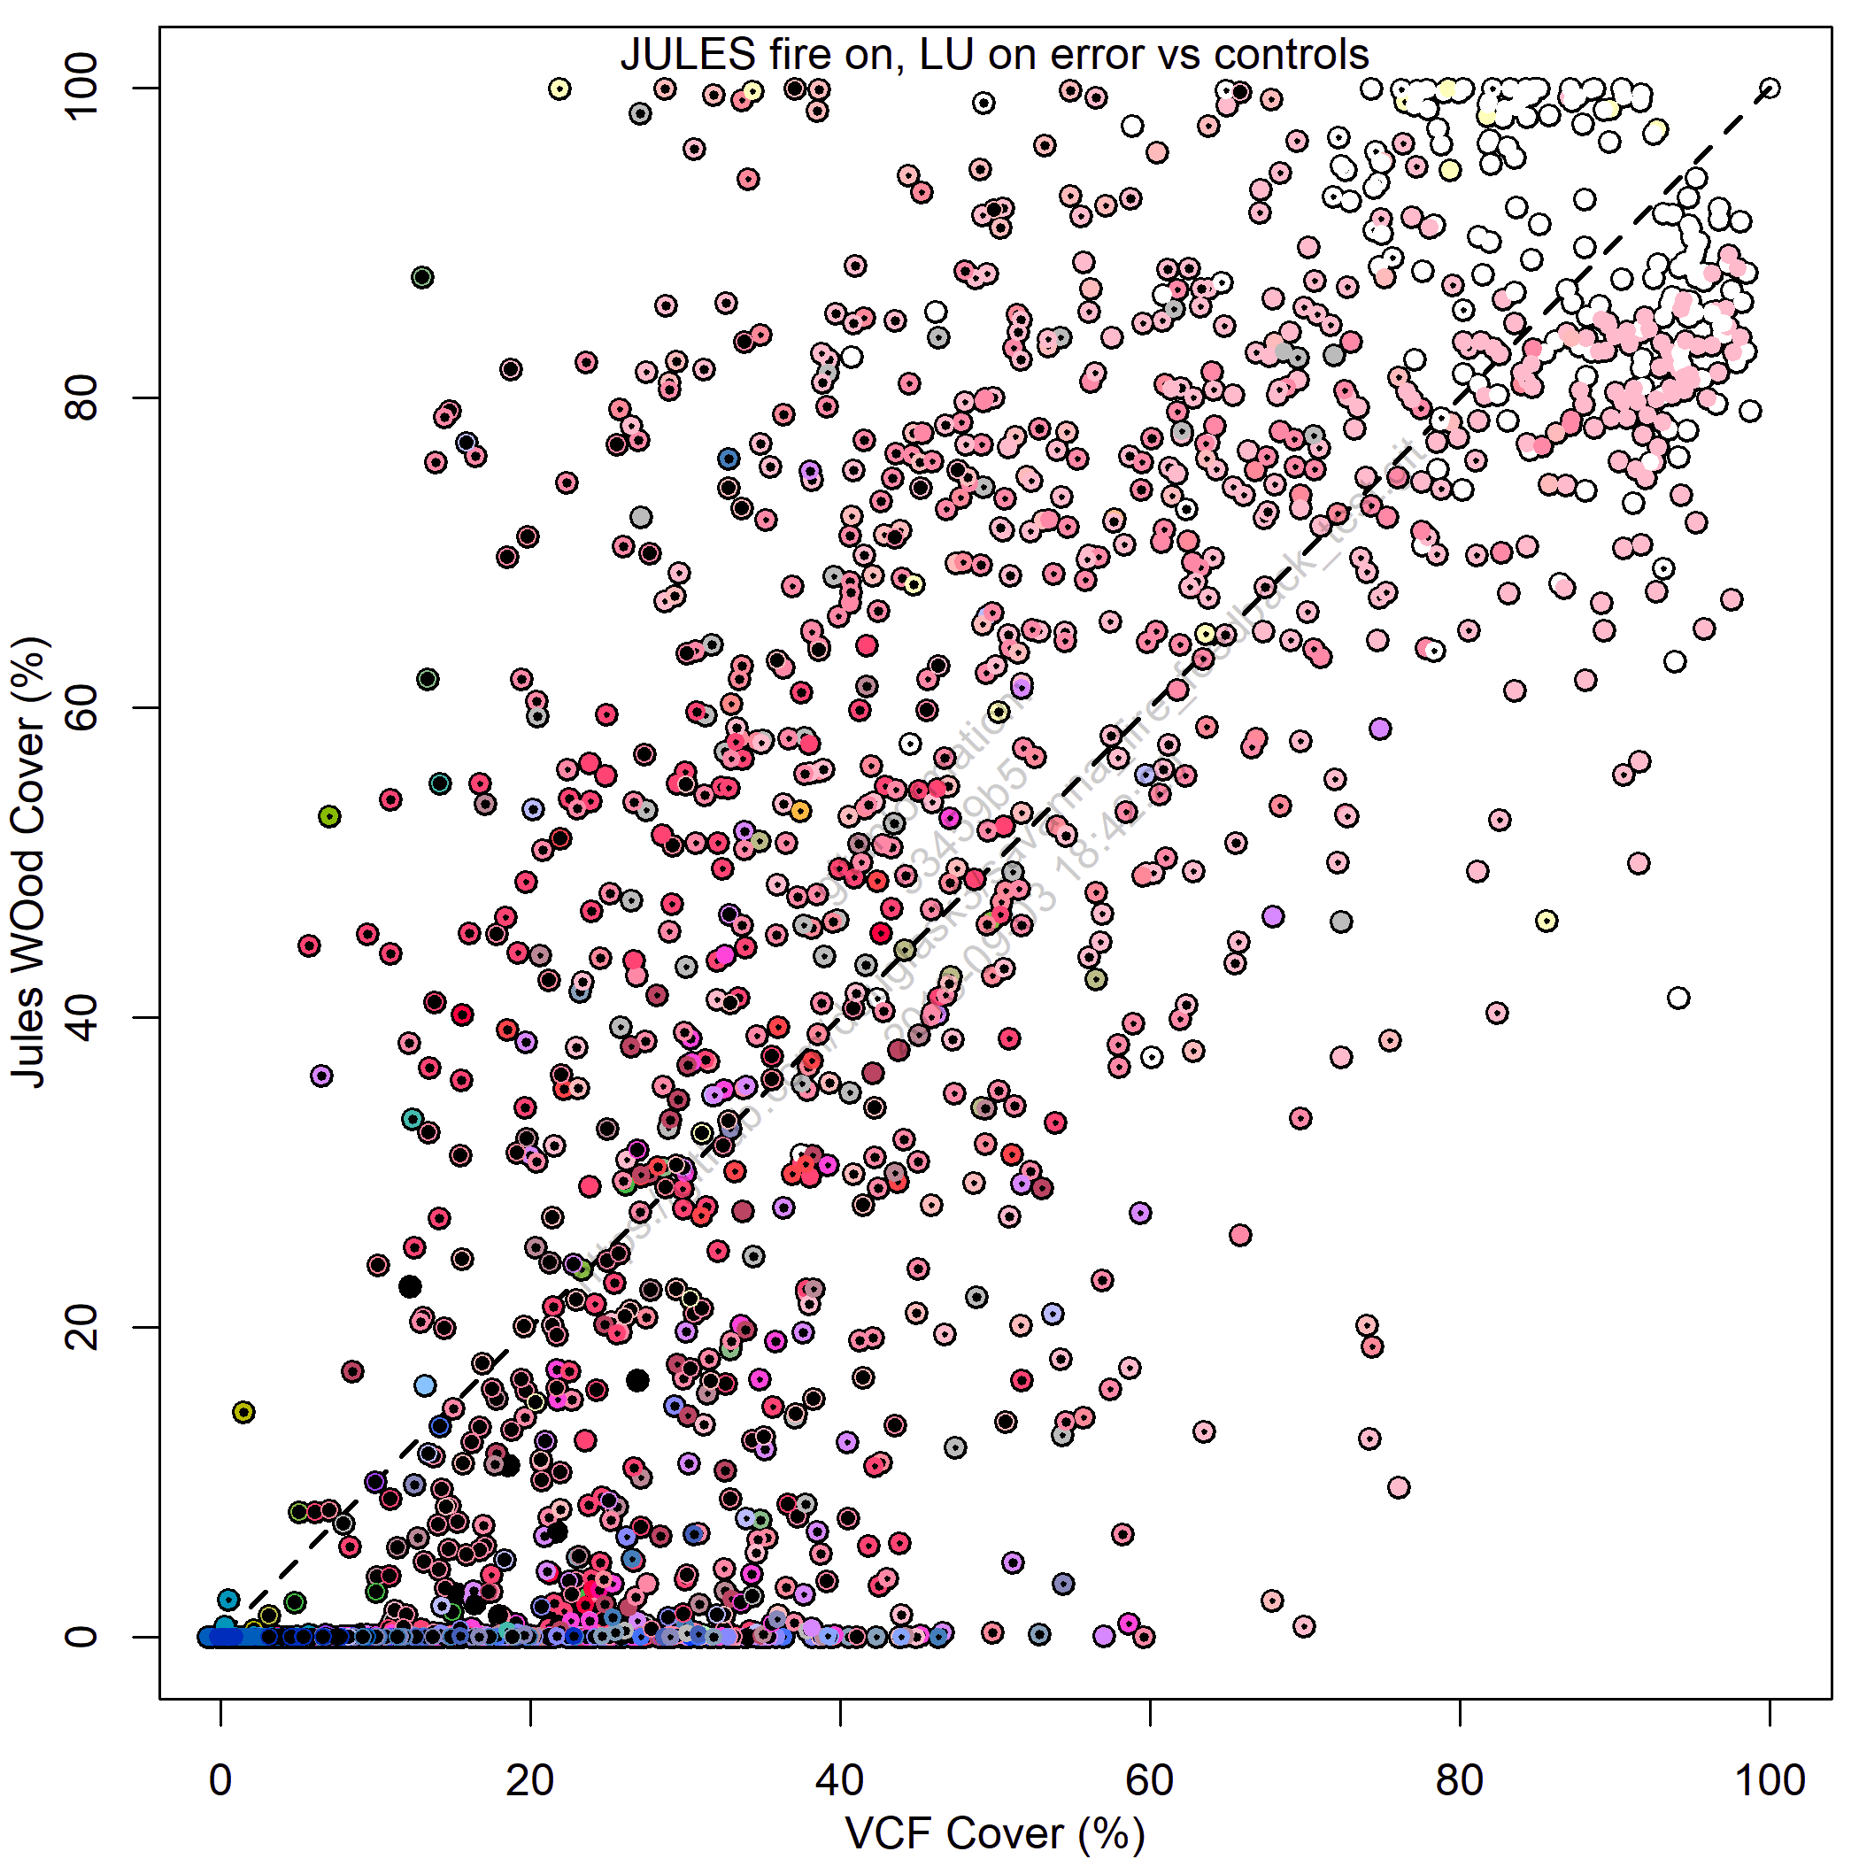
Jules Comparison - SF3
Some mortality not accounted for
LU areas now reduced by too much
Fire reduces tree cover to 0 for
many areas

Slide 33
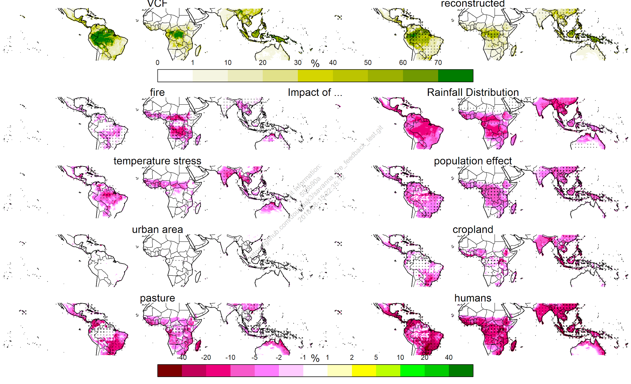
Mortality types

Slide 34
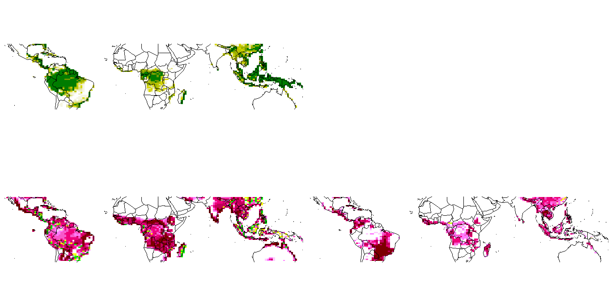
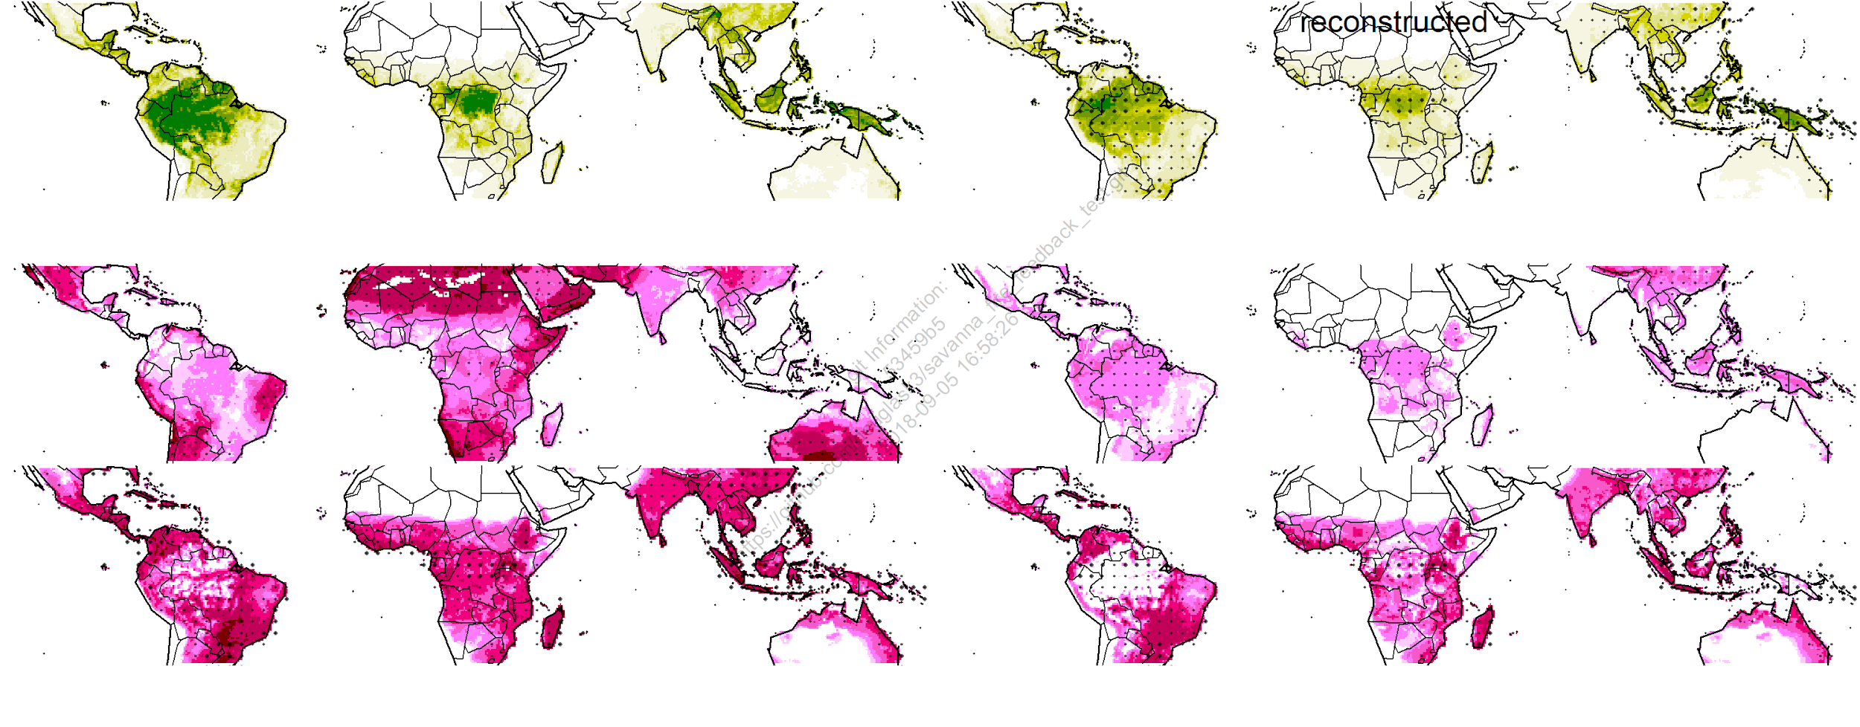
Mortality types
VCF
JULES
Land
Use
Burnt
Area
All
Disturb

Slide 35
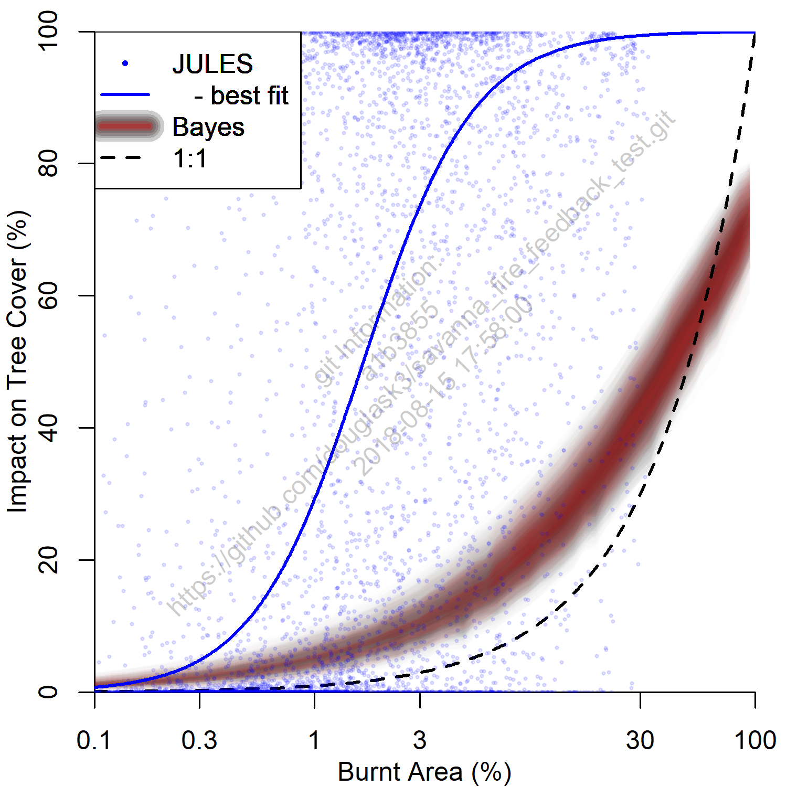
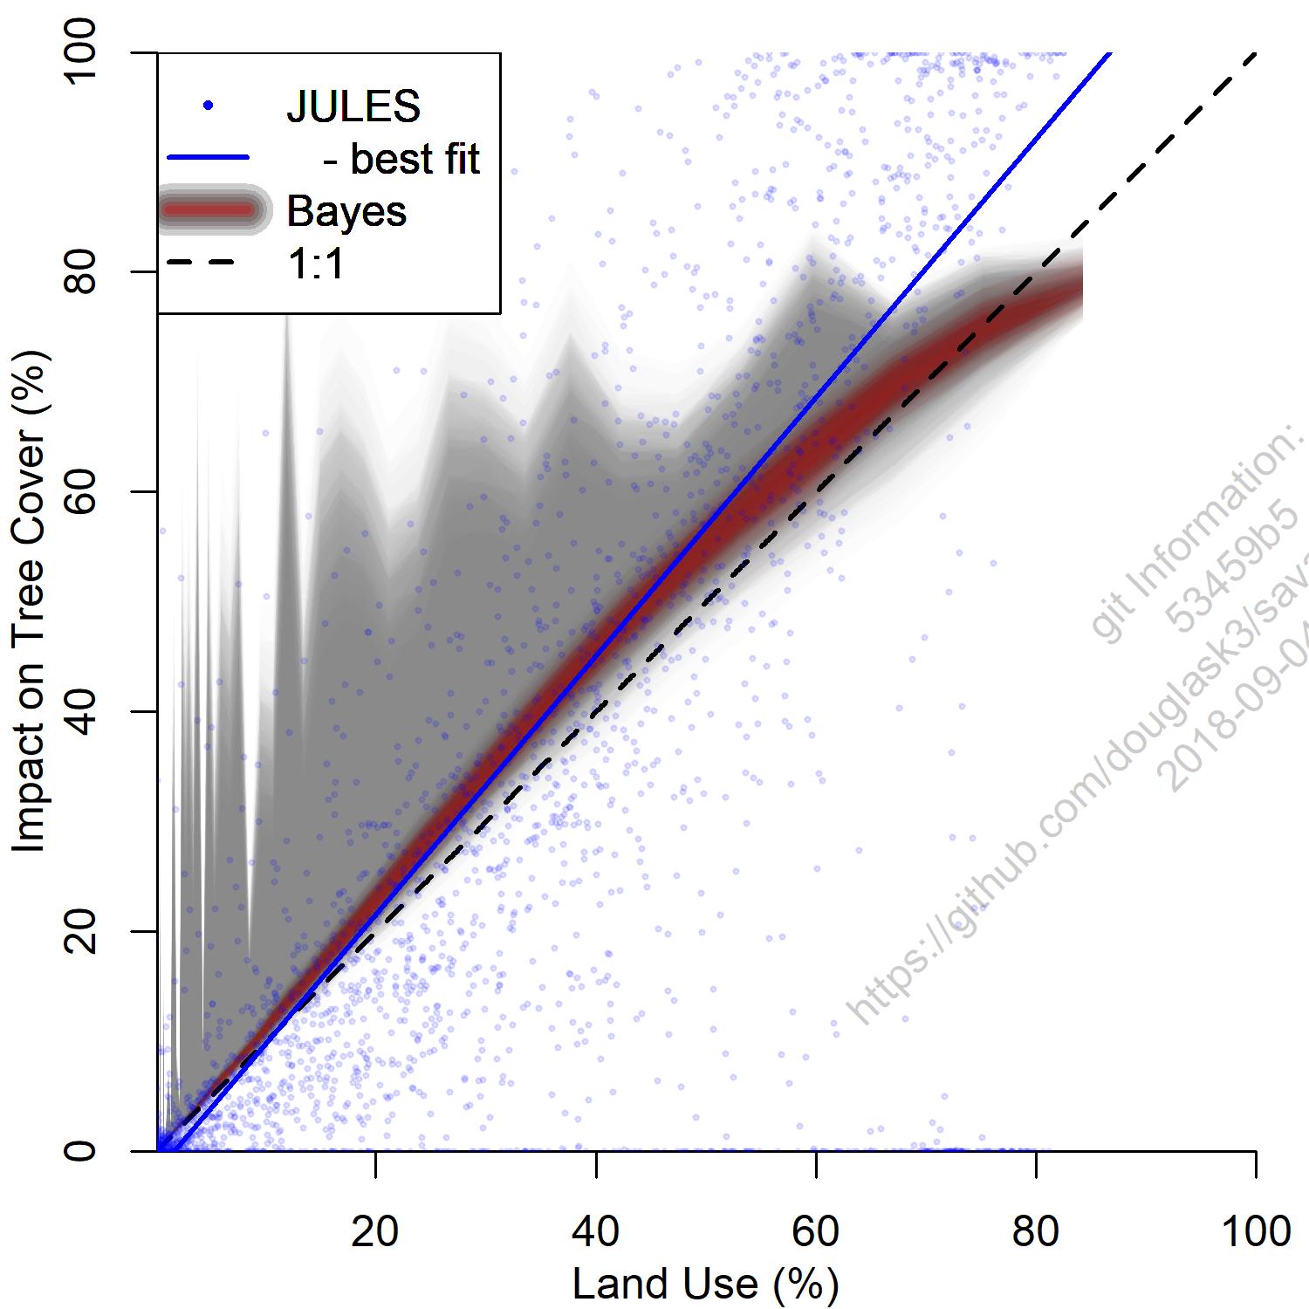
Mortality types
Burnt Area
Same for LU
Land Use

Slide 36
Summary of biases
Too much tree cover at low MAP
Reasonable land use impact
Fire “overkill”
Fire double-counts land use impact (untested in other LSMs?)
Some mortality types not represented (although extent for some unknown)

Slide 37
Mortality or Recovery?
Impact on tree cover an (unknown) combination of mortality and recovery
Test and compare different veg recovery techniques:
Fiddle with minimum LAI before vegetation spreads
Reduce carbon density for low veg fracs
Introduce simple build of seedbank.
Add in a non-structural carbohydrate pool for disturbed veg to draw on

Slide 38
Optimised TRIFFID
TRIFFID:
(Burton et al. 2018, GMD)

Slide 39
Optimised TRIFFID
TRIFFID:
(Burton et al. 2018, GMD)

Slide 40
Optimised TRIFFID
TRIFFID:
(Burton et al. 2018, GMD)
From JULES-ES output
Initialized
from
JULES-ES
Output or obs?

Slide 41
Optimised TRIFFID
TRIFFID:
(Burton et al. 2018, GMD)
Optimise
against obs
From JULES-ES output
Optimize
Optimize
Initialized
from
JULES-ES
Output or obs?

Slide 42
Optimised TRIFFID
TRIFFID:
(Burton et al. 2018, GMD)
Optimise
against obs
From JULES-ES output
Optimize
Optimize
Initialized
from
JULES-ES
Output or obs?
Drought,
Max. temp
people
NSC/recovery carbon

Slide 43

The “ x” JPEG
More help with “other” JPEGs please
  Someone to organize observations/phonology JPEG
  More help with bare soil, particularly outside of UKESM
Vegetation mortality JPEG is doing alright.

Slide 44

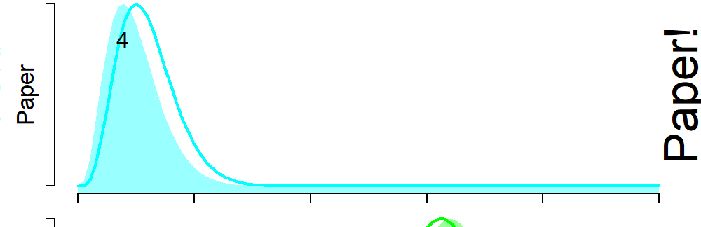
Number of JULES talks with dinos in...
0%
50%
100%

Slide 45
Number of JULES talks with dinos in...
0%
50%
100%

Slide 46
Number of JULES talks with dinos in...
0%
50%
100%

Slide 47
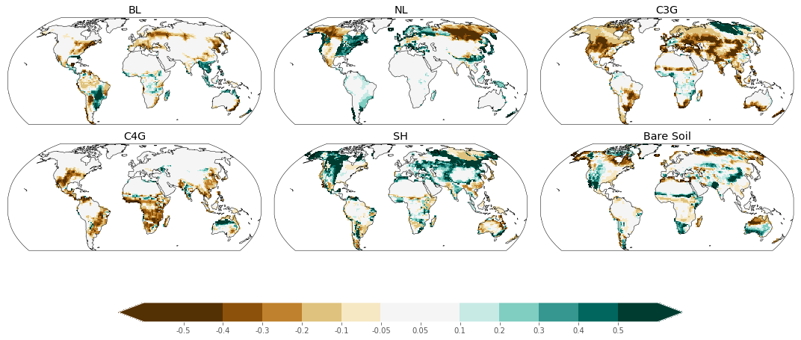
Arid
Same for LU

Slide 48
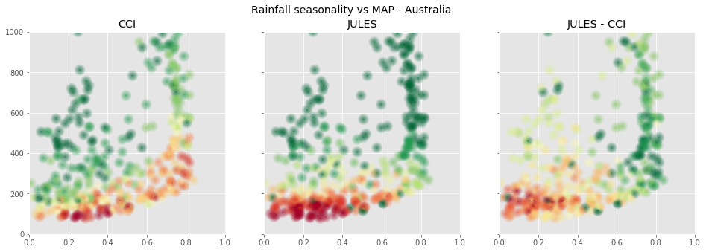
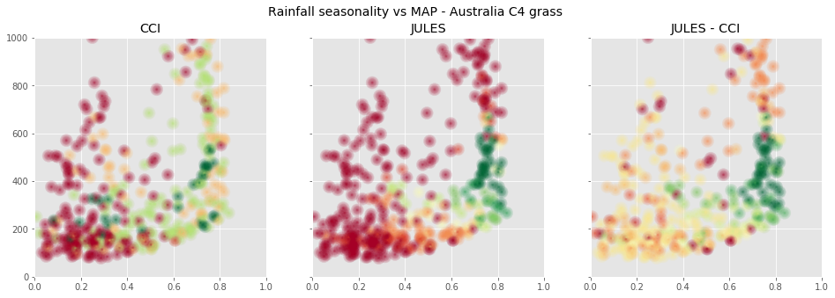
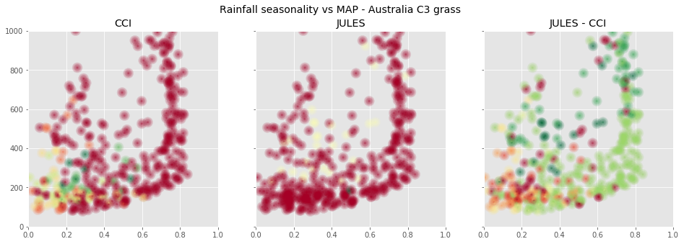
Arid
Same for LU

Slide 50
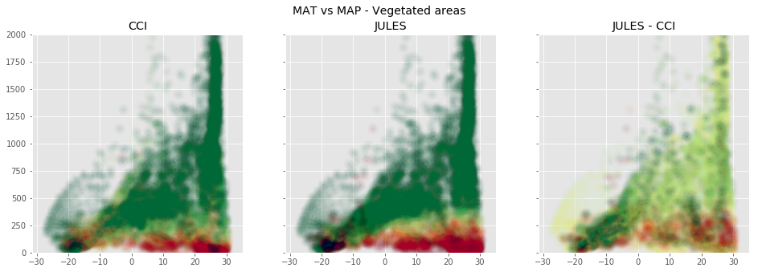

Slide 51
Veg Distribution plans
Total veg/tree+shrub version of simple model
Tree recovery rate in JULES
Triffid optimization

Slide 52
Life form | VCF | 2002-2012 | MM |  | 0.6 | 0.62 | 0.81 +/- 0.0034 | 0.78 | 0.6 | 0.54 | 0.51
 | CCI | 2010 |  |  | 0.76 | 0.77 | 0.99 +/-0.0068 | 0.72 | 0.6 | 0.64 | 0.63
Tree Cover |  |  |  |  | 0.39 | 0.4 | 0.51 +/- 0.0048 | 0.35 | 0.28 | 0.3 | 0.3
Wood Cover | VCF | 2002-2012 |  |  | 0.33 | 0.34 | 0.44 +/- 0.002 | 0.64 | 0.43 | 0.33 | 0.29
 | CCI | 2010 |  |  | 0.47 | 0.47 | 0.62 +/- 0.0061 | 0.45 | 0.31 | 0.35 | 0.36
Herb cover | VCF | 2002-2012 |  |  | 0.38 | 0.39 | 0.54 +/- 0.0046 | 0.64 | 0.48 | 0.43 | 0.42
 | CCI | 2010 |  |  | 0.41 | 0.4 | 0.53 +/- 0.0039 | 0.43 | 0.33 | 0.4 | 0.42
Leaf type | VCF | 1992-1993 |  |  | 0.75 | 0.77 | 0.93 +/-0.014 | 0.56 | 0.55 | 0.5 | 0.53
 | CCI | 2010 |  |  | 0.57 | 0.66 | 0.81 +/- 0.0078 | 0.56 | 0.56 | 0.51 | 0.54
BL |  |  |  |  | 0.27 | 0.3 | 0.38 +/- 0.0032 | 0.18 | 0.15 | 0.17 | 0.17
NL |  |  |  |  | 0.16 | 0.23 | 0.27 +/- 0.0021 | 0.25 | 0.22 | 0.18 | 0.17
C3 |  |  |  |  | 0.31 | 0.32 | 0.44 +/- 0.0035 | 0.34 | 0.36 | 0.38 | 0.43
C4 |  |  |  |  | 0.23 | 0.26 | 0.31 +/- 0.0021 | 0.2 | 0.21 | 0.21 | 0.21
Shrub |  |  |  |  | 0.14 | 0.14 | 0.2 +/- 0.0013 | 0.36 | 0.28 | 0.26 | 0.23

Slide 53
 |  |  | No fire, No LU
Life form | VCF | 2002-2012 | 0.78 | 0.6 | 0.54 | 0.51
 | CCI | 2010 | 0.72 | 0.6 | 0.64 | 0.63
Tree Cover |  |  | 0.35 | 0.28 | 0.3 | 0.3
Wood Cover | VCF | 2002-2012 | 0.64 | 0.43 | 0.33 | 0.29
 | CCI | 2010 | 0.45 | 0.31 | 0.35 | 0.36
Herb cover | VCF | 2002-2012 | 0.64 | 0.48 | 0.43 | 0.42
 | CCI | 2010 | 0.43 | 0.33 | 0.4 | 0.42
Leaf type | VCF | 1992-1993 | 0.56 | 0.55 | 0.5 | 0.53
 | CCI | 2010 | 0.56 | 0.56 | 0.51 | 0.54
BL |  |  | 0.18 | 0.15 | 0.17 | 0.17
NL |  |  | 0.25 | 0.22 | 0.18 | 0.17
C3 |  |  | 0.34 | 0.36 | 0.38 | 0.43
C4 |  |  | 0.2 | 0.21 | 0.21 | 0.21

Slide 54
Comparison | Dataset | Time period | - | LU | Fire | LU + Fire
Life form | VCF | 2002-2012 | 0.78 | 0.6 | 0.54 | 0.51
 | CCI | 2010 | 0.72 | 0.6 | 0.64 | 0.63
Tree Cover |  |  | 0.35 | 0.28 | 0.3 | 0.3
Wood Cover | VCF | 2002-2012 | 0.64 | 0.43 | 0.33 | 0.29
 | CCI | 2010 | 0.45 | 0.31 | 0.35 | 0.36
Herb cover | VCF | 2002-2012 | 0.64 | 0.48 | 0.43 | 0.42
 | CCI | 2010 | 0.43 | 0.33 | 0.4 | 0.42
Leaf type | VCF | 1992-1993 | 0.56 | 0.55 | 0.5 | 0.53
 | CCI | 2010 | 0.56 | 0.56 | 0.51 | 0.54
BL |  |  | 0.18 | 0.15 | 0.17 | 0.17
NL |  |  | 0.25 | 0.22 | 0.18 | 0.17
C3 |  |  | 0.34 | 0.36 | 0.38 | 0.43
C4 |  |  | 0.2 | 0.21 | 0.21 | 0.21
Shrub |  |  | 0.36 | 0.28 | 0.26 | 0.23

Slide 56
Sub-JPEGS
Collate LAI datasets
Observations JPEG
Veg frac with uncertainty estimates
to help JULES evaluation/calibration
Reduce uncertainty with CCI based on high resolution original data
“Mortality” JPEG
Productive vegetation competition and distribution
Representation and magnitude of disturbance
Post-disturbance recovery rate
Arid-veg JPEG
Too high bare soil in arid regions
Vegetation can be over-sensitive to moisture availability
Test response to variability at different timescales (seasonal, annual, decadale etc)
Phenology JPEG
Lack of cold deciduousness in grasses
Drought phenology untested
Assessment of veg-frac “shrinkage” from seasonal carbon starvation

Slide 57
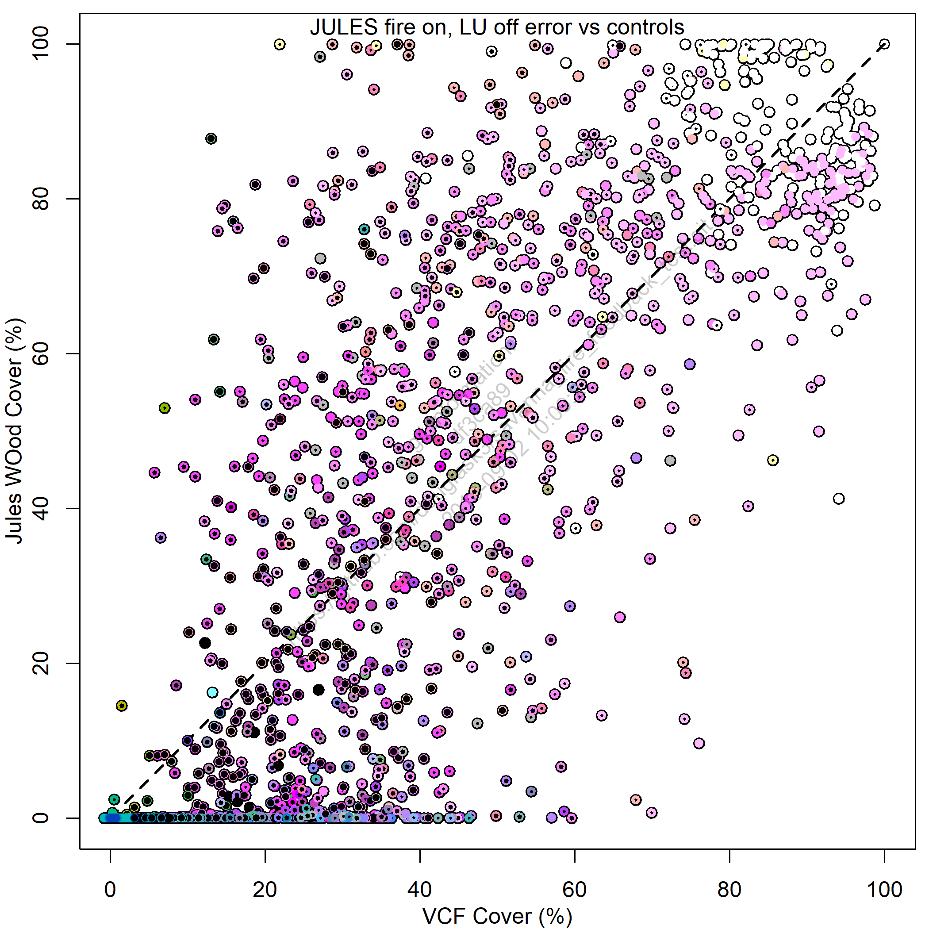
Diagnosing Tree Cover bias
% Tree Cover
Coloured by main control
Controls on vegetation
Simulation
Jules - Observations
Observations

